Slide 1
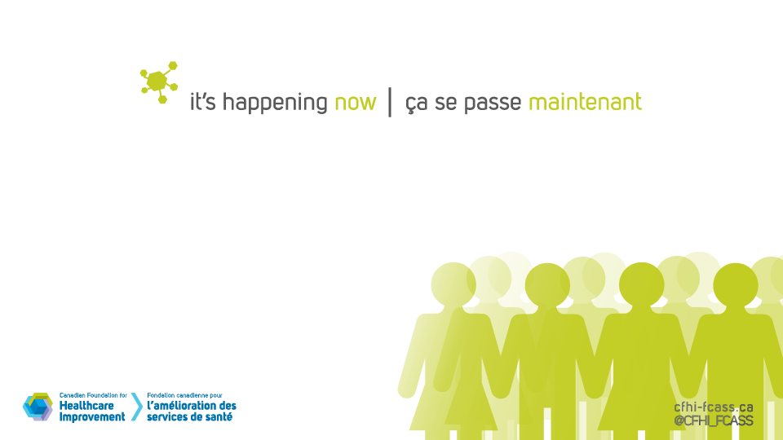

Patient Engagement - Catalyzing Improvement and Innovation in Healthcare
Breakfast with the Chiefs
December 7, 2016

Slide 2
Our Panelists
Maria Judd, Senior Director, Canadian Foundation for Healthcare Improvement
Dr. G. Ross Baker, Professor, Institute of Health Policy, Management and Evaluation, University of Toronto and Program Lead for the MSc. Program in Quality Improvement and Patient Safety.
Patty O’Connor, Clinical Improvement advisor and Faculty, Canadian Foundation for Healthcare Improvement and former Director of Nursing, McGill University Health Centre
Dr. Petrina McGrath,Vice President People, Practice and Quality at Saskatoon Health Region and Safety Strategy Lead
cfhi-fcass.ca
@CFHI_FCASS

Slide 3


Chapter 1 McGill University Health Centre
Chapter 2 Kingston General Hospital
Chapter 3 Augusta University Health System
Chapter 4 Cincinnati Children’s Hospital Medical Center
Chapter 5 Whittington Health Respiratory Service
Chapter 6 Northumbria Healthcare Trust
Chapter 7 Patients as Partners
Chapter 8 Northumberland Community Partnership
Chapter 9 Collaborative Chronic Care Network
Chapter 10 Saskatchewan Health Quality Council and Saskatoon Health Region

Slide 4
Mission
CFHI identifies proven innovations and accelerates their spread across Canada by supporting healthcare organizations to adapt, implement and measure improvements in patient care, population health and value for money.
Build leadership and skill capacity
Create collaboratives to spread evidence-informed improvement
Enable patient, family and community engagement
Apply improvement methods
Notes:
Armand
CFHI is a not-for-profit healthcare improvement organization funded through an agreement with the Federal Government.
Our mission is to identify proven innovation and accelerate their spread across Canada by supporting healthcare organizations to adapt, implement and measure improvements in patient care, population health and value for money.
We do this by helping improvement teams from different jurisdictions work together on common improvement priorities and providing opportunities to lead, share, and implement evidence-informed solutions across regions, provinces, and territories.
Our work focuses on four core areas within our programming:
Build leadership and skill capacity: We enhance organizational capacity to champion and lead improvement
Enable patient, family and community engagement: We catalyze healthcare innovation by involving those who experience, and need care as experts in improvement and co-design
Apply improvement methodology: We use improvement tools and methods to drive measureable results towards better patient care, better health and better value
Create collaboratives to spread evidence-informed improvement: We bring together "coalitions of the willing" and support these networks of change agents to implement improvement across Canada. Our presentation today will focus on ongoing work taking place in the province of Quebec that was supported by one of our collaboratives.

Slide 5
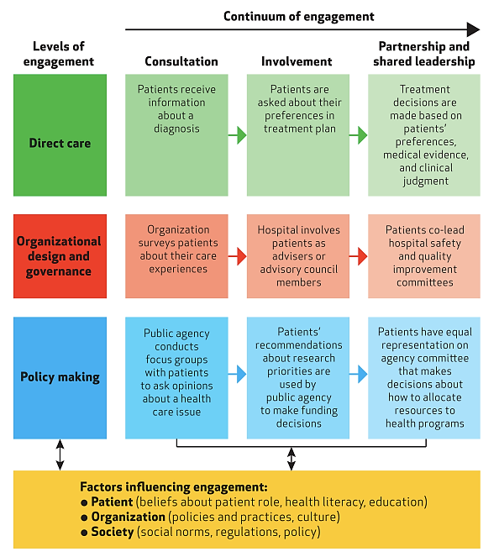
Improved health outcomes & changes in service utilization
Patient & organizational improvements e.g patient experience, safety and effectiveness
Changes in
improvement priorities
& resourcing
Source: Carman, et al.,
Health Affairs, 2013
Notes:
Last year at MUHC ISAI I talked about IAP2 and foundaitons for meaningful engagement…
Reference Carman and handout…
Note interplay between levels
Note value – ROI at each level
1) Direct care – patient engagement often referered to as patient activitation (define) and measured with PAM measure
http://e-patients.net/archives/2015/03/health-affairs-activation.html reference J. Greene
Note associated with improved health outcomes such as HDL, obesity,
Service utilization – fewer hospitalization and ED visits
2) Org design and governance (Note ROI from Baker and Judd CFHI Evidence Boost: benefits for organizations and service design and delivery – esp safety and effectiveness
3) Policy making: e.g. from Antoine Bovin’s work (Implementation Science article) . “Patient involvement can change priorities driving healthcare improvement at the population level”. Priorities established by professionals alone placed more emphasis on the technical quality of CDM. Patients placed more emphasis on required resources to support self-mgt and communication tools and development for provider-patient relationships. Note: why providers need to be supported with new trainining and education for different role and communication with patients for shared decision making (coach role vs fixer role)
NOTE: organizations that support engagement at all 3 levels of health care systems and all levels of engagement see greater benefits for all involved!!!

Slide 6



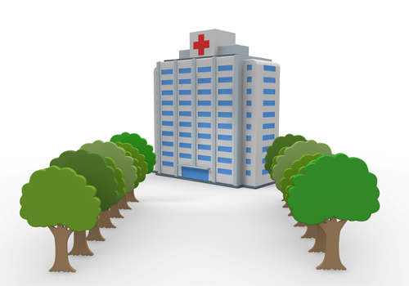
Engagement-capable environments:
An environment that responds to the needs and desires of patients and the population they are responsible for; that fosters a culture of patient-centredness; and builds the infrastructure supporting active and meaningful engagement of patients, staff and leaders to improve the quality of care.
Thus, an engagement-capable environment fosters engagement and partnerships at all levels of care:
• The individual level, where patients and families partner with healthcare providers in their own care
• The organizational level, where patients and families engage in the design, implementation and evaluation of service delivery and processes of care
• The policy level, where patients, families and the community engage to determine appropriate policy within organizations or, more broadly, at the level of government”

Slide 7
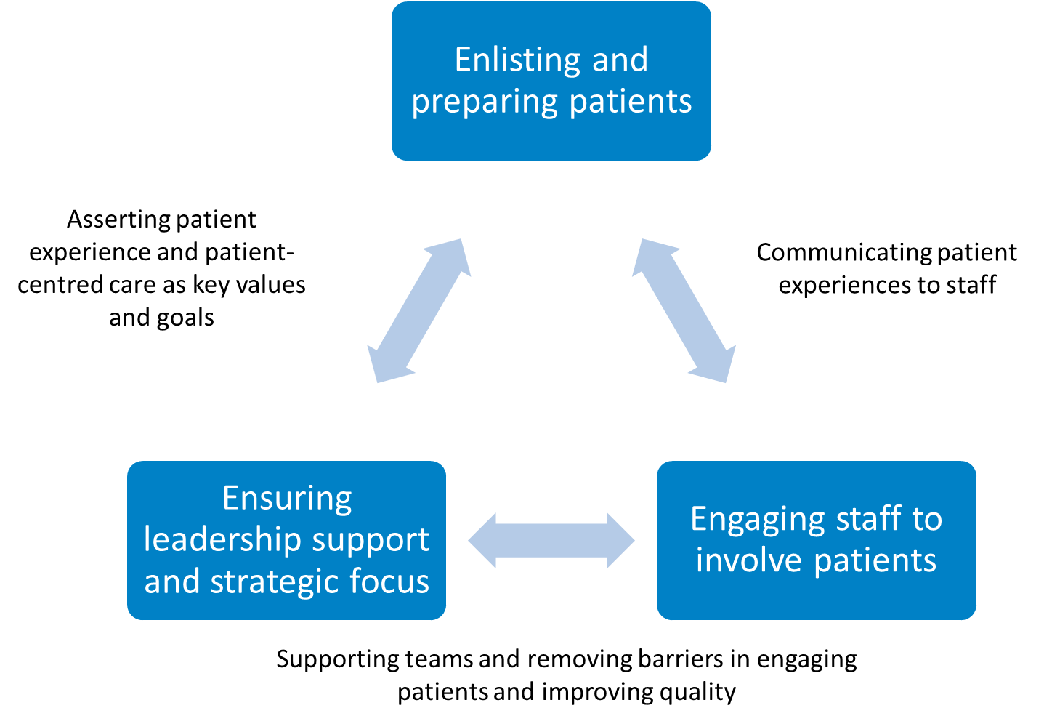
Engagement-capable environments:

Slide 8
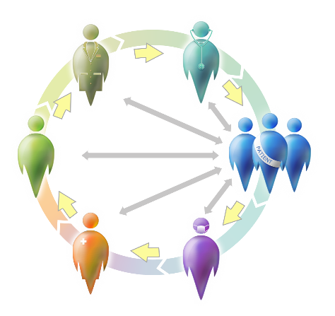

Patients and Professionals Partnering to Co-design Care for Improved Outcomes
McGill University Health Centre
Notes:
In 2010, fresh off a Harkness Fellowship completed in the States—and as the CNO at the McGill Univ HC, I launched a new program aimed at building organizational capacity for quality improvement with IP frontline care providers – and patients. At the time, we had begun the largest HC redevelopment project in Canada that would consolidate our 6 hospitals onto 3 campuses – including the construction of a new 500 bed facility.

Slide 9

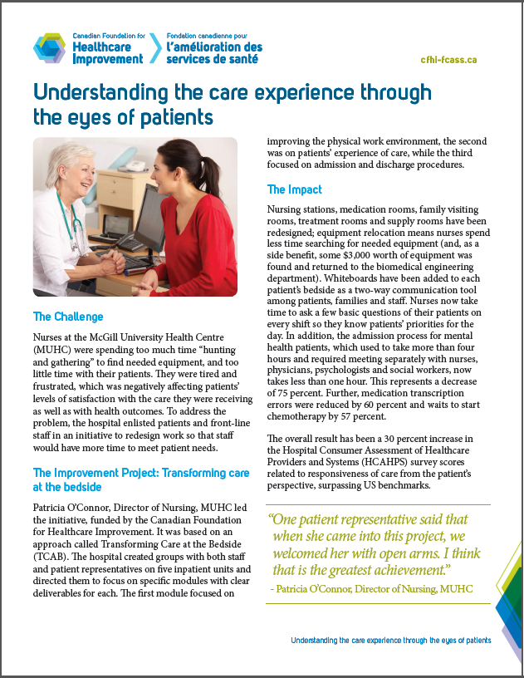
McGill University Health Centre
A CFHI-funded PEP initiative
Notes:
The move, which involved reducing the total number of inpatient beds and outpatient activity, prompted senior leaders to rethink how care processes should be redesigned in light of this new reality. Also concerned with low staff morale, I knew that we needed to engage the hearts and minds of our bedside caregivers who I believed had enormous untapped talents for improving service delivery and QofC.
With initial funding from CFHI and the Newton Foundation, we launched the Transforming Care at the Bedside program --- empowering both bedside practitioners and patient advisors in learning how to co-design changes to improve patient, staff and organizational outcomes.

Slide 10
Transforming Care at the Bedside (TCAB):
A Blueprint for Change
Transformational Leadership at all Levels
Safe &
Reliable
Care
Patient/ Family
Centered
Care
Vitality
&
Teamwork
Value-Added
Care
Processes
Patient and Family as Co-design Partners
Notes:
Designed by the IHI and initially tested in 13 leading US hospitals, TCAB engages the hearts and minds of frontline staff to lead quality improvement, using rapid cycle improvement processes.
It’s 5 pillars are:
safe/reliable care, PFCC, teamwork,
value-add care processes and transformational leadership.
At the MUHC, we added a 6th pillar from the outset-- Pts./families as co-design partners --- given our belief that patient would bring different insights and better outcomes.
Transforming Care at the Bedside (TCAB) engages staff & patient advisors to co-design new care processes, reduce waste and improve outcomes.
Staff and patients receive TCAB education together and jointly focus on improvement initiatives.

Slide 11
3 Objectives
Objective
# 1
Understand the inpatient experience “through the eyes of patients & families”
Deeply engage patients & families, along with staff, in reshaping care processes that respond to their real needs, thus improving: safety, access & work environment.
Objective
# 2
Objective
# 3
Increase RN time in direct care
Notes:
Three main objectives guided our work :
To understand care through the eyes of patients and families and improve the patient experience of care;
To partner patients and families with the care providers to redesign care processes that respond to their real needs; and
to increasing nurse time spent in direct care.
We rolled out 4 consecutive implementation waves betw. 2010-14, on inpt. units, ERs, ORs and dialysis. Each wave consisted of structured learning modules, each approx. 10 weeks. Workshops, combined with hands-on applied learning one day per week with the unit-based teams, focused on developing skills in four areas:
a) rapid cycle improvement processes using PDSA;
b) LEAN 5S methods;
c) a patient experience of care module targeted a bundle of three interventions e.g. whiteboards at the bedside, therapeutic questions, and hourly intentional rounds; and
d) process mapping to improve admission and discharge processes.
Guided by the principle of “Nothing about me, without me”, patients were included from the very beginning in the redesign work. Each unit had 2 advisors embedded as members of unit-based improvement teams, and we paid for release time of one day/wk for 4 frontline caregivers.
Every week this core group of staff and pt advisors met for a full day, identifying the problems in care delivery they wanted to address & then conducting tests of change—adapting, adopting or abandoning ideas as they went. Patient advisors assumed leadership in contacts with in-patients e.g. describing TCAB aims to patients, co-planning tests of change, and obtaining patient fdbk on the changes. Patients were on the evaluation team, helping us apply for grants & overseeing all measurements. And then they have co-presented the findings locally and internationally.

Slide 12

Measures for Accountability
  Patients:
    Experience of care (HCAHPS)
    Interviews post-discharge
  Quality of care:
    Access, timeliness of care, reduced safety risks, pressure ulcers, pain, nosocomial infections
  Staff:
    Time in direct care & value-add care
    Team effectiveness, global work satisfaction, work engagement, capacity to lead quality improvement, turnover, overtime
  Managers:
    Self-efficacy, global work satisfaction, worklife, capacity to lead quality improvement
  Patient engagement:
    Focus groups
  +++ PDSAs
Notes:
Our Eval’n approach included organization-level and unit-level data, measuring:
1. Time in direct care & value-add care (time-motion using personal digital-assist devices)
2. Patient experience of care: HCAHPS Surveys & Interviews at patient’s home post-discharge
3. Patient engagement process: multiple focus groups were held with patient representatives to get their fdbk. On how to improve the program & their involvement.
Multiple Quality of care indicators were tracked: Access, timeliness of care, falls, pressure ulcers, pain, nosoc. Infections
Knowing full well that staff experience and work satisfaction drives pt experience, this initiative put decision-making about changes needed into the hands of the direct caregivers. We then tracked impacts on:
5. Multiple measures of work satis’n, team effectiveness, and capacity to lead quality improvement, as well as turnover, overtime rates
6. And at the unit-level, clinical staff learned how to do frequent pre and post measures of change related to the tests of change. They posted all results in public view and received feedback and encouragement during Executive Rounds conducted on the units.

Slide 13
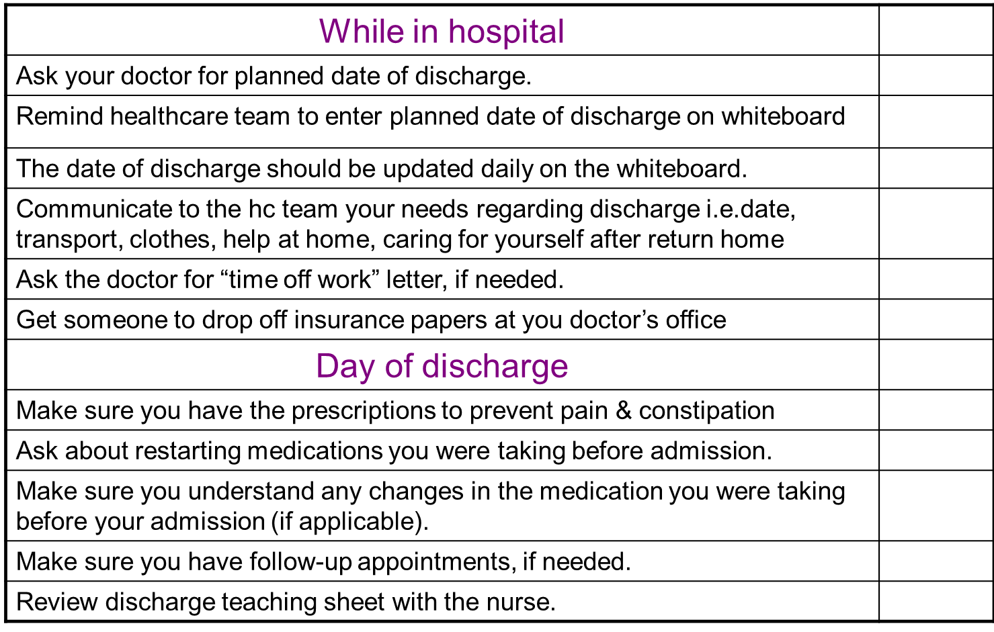
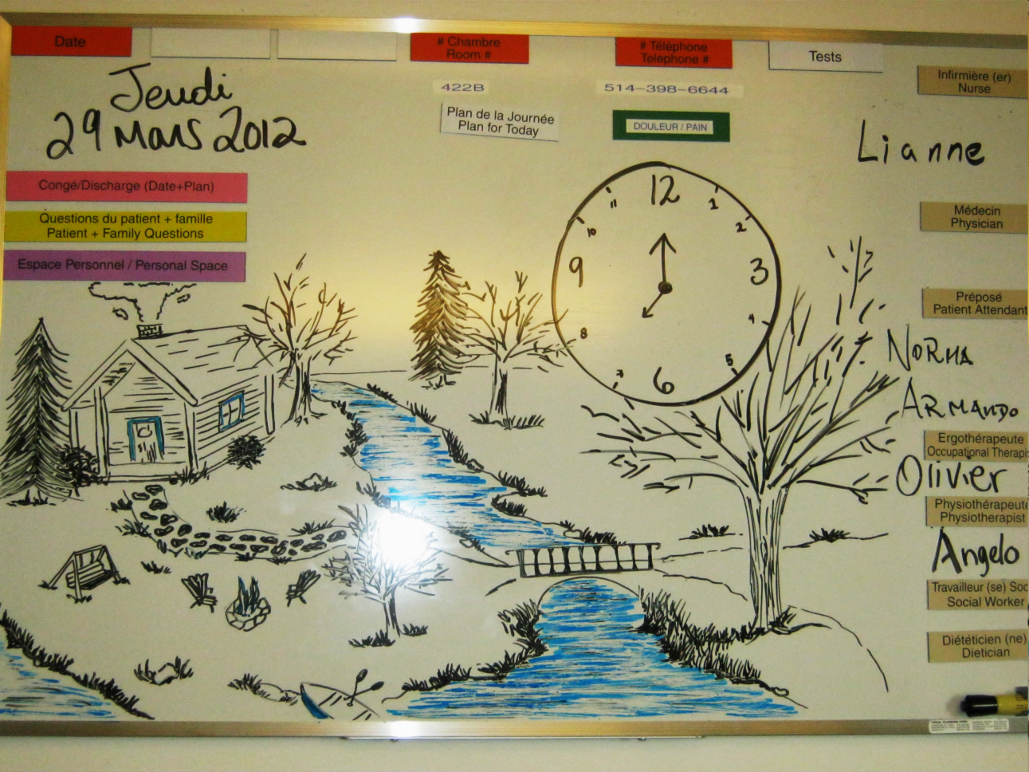
Patient & Family Outcomes
20% ↑ in “responsiveness of care” (HCAHPS)
Patient satisfaction doubled with new interprofessional “joint team” admission process in Psychiatry, reducing admission time from 4.2 hours to 1 hr.
25% ↓ in C-difficile and VRE infections
Bedside whiteboards improved two-way communication
Hourly rounding ↓ call bell use, ↑ pt. satisfaction, ↑ pain mng’t
Multiple Patient-designed improvements
Notes:
Patient Outcomes tracked over the 4 years, included:
20% ↑ in “responsiveness of care” (HCAHPS)
Patient satisfaction doubled with new interprofessional “joint team” admission process in Psychiatry, reducing admission time from 4.2 hours to 1 hr.
25% ↓ in C-difficile and VRE infections
Bedside whiteboards improved two-way communication between patients, families and staff
Intentional “comfort” rounding at bedside reduced call bell use, ↑ pt. satisfaction;
Patient-designed improvements:
New patient handbooks, discharge checklists for patients
Re-designed Family visiting rooms
The % of Dialysis pts receiving their monthly blood results went from 40 to 100%

Slide 14
Staff Outcomes
45% of clinical staff in 6 hospitals gained new QI skills
8% increase↑ in registered nurse direct time in bedside care
Significant ↓ in non-value-add work using LEAN 5S and waste walks (re-design of Nursing stations, medication and treatment rooms, supply rooms, staff lounges and patient dining areas)
Quiet zone for nurses they created → 50% ↓ in medication interruptions and 60% ↓ in medication transcription errors
Statistically significant improvements on Team effectiveness, Turnover and Overtime rates
Want patients for co-design on all units
Notes:
Staff Outcomes were impressive and clearly demonstrated the positive impacts providing them with new competencies:
45% of clinical staff in 6 hospitals gained new QI skills
8% increase in registered nurse direct time in bedside care
Significant ↓ in non-value-add work using LEAN 5S and waste walks (re-design of Nursing stations, medication and treatment rooms, supply rooms, staff lounges and patient dining areas)
Quiet zone for nurses they created → 50% ↓ in medication interruptions and 60% ↓ in medication transcription errors
Statistically significant improvements on Team effectiveness, Turnover and Overtime rates
And there was Unanimous support to include patients in co-design on all units

Slide 15
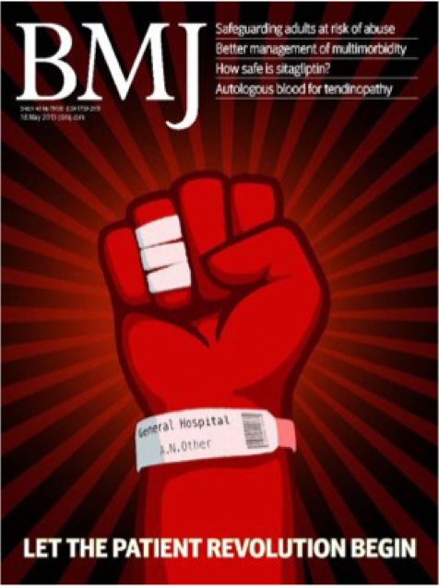
Organizational Outcomes
Spread and Sustainabillity
2 Leading Practices (Accreditation Canada-2014)
Improved supplies management: $3,000/unit of items returned to Biomed
Managers perceived greater self-efficacy
Accelerated gains on other corporate priorities (Pt Flow, Inf C)
++ improved relationship with Nurses union
38 initial highly skilled Patient advisors
Resourcing new infrastructure to support pt eng’t in all QI activities in all major programs
Notes:
At the organiz’l level, the changes were also evident:
Spread and Sustainabillity:
4 successive implementation waves (2010-15)
Greater capacity to lead systematic QI across 6 hospitals
Grants = $1M (CFHI, CIHR, Max Bell Fnd, Newton & MGH Fnd’s)
$1.6M in-kind investments supported spread/ sustainability
2 Leading Practices by Accreditation Canada (2014): for the TCAB program and specifically, for the joint admission process on our mental health unit.
Improved supplies management: $3,000/unit of items returned to Biomed
Managers perceived greater self-efficacy
Accelerated gains on other corporate priorities (Pt Flow, Inf C)
++ improved relationship with Nurses union
38 initial highly skilled Patient advisors
Led to resourcing new infrastructure to support pt eng’t in all QI activities in all major programs (2 new Pt Partnership coord’r roles, systematic approach to Recruit’t and training of Pt advisors and staff, Quality committees within each major program now have pt advisors.

Slide 16

Key Elements of Success
Courageous, cohesive leadership at all levels who “walk the talk”
Extensive stakeholder engagement
Recruitment of patient advisors with clear roles & responsibilities, at all levels of decision-making
Structured and mutual learning environment for patient advisors, staff and physicians
Coaching & facilitation support
Continuous feedback loops & outcome measurement
Resources
Relentless communication of results
Notes:
The following were the key elements of success in cultivating an engagement-capable environment:
1. Courageous, cohesive leadership at all levels who “walk the talk” . A large range of leadership actions were used to support co-design efforts.
Executive rounds were held at regular intervals on the TCAB units; exec leaders provided on-the-spot written feedback on the team’s progress.
Regular Sr. leader presence was critical to support managers
Ongoing Coaching support to the project lead, local champions and implem’n team.
Being vigilant in Removing barriers & providing resources as needed
Regular mtgs with bedside caregivers & Pt. advisors to review challenges & try new strategies
2. Extensive stakeholder engagement was partic’ly helpful for spread plans
3. Recruitment of patient advisors with clear roles & responsibilities, at all levels of decision-making
4. Creation of structured & mutual learning environment for patient advisors, staff and physicians.
5. Coaching & facilitation support: this doesn’t come naturally to staff.
6. Continuous feedback loops & outcome measurement, incl’g smart use of technology. Discussing results of pt experience or QoC measures with frontline staff is what drives the next steps of change. Resources (release time, grants)
7. Resources: protected release time for learning.
8. Relentless communication of results

Slide 17
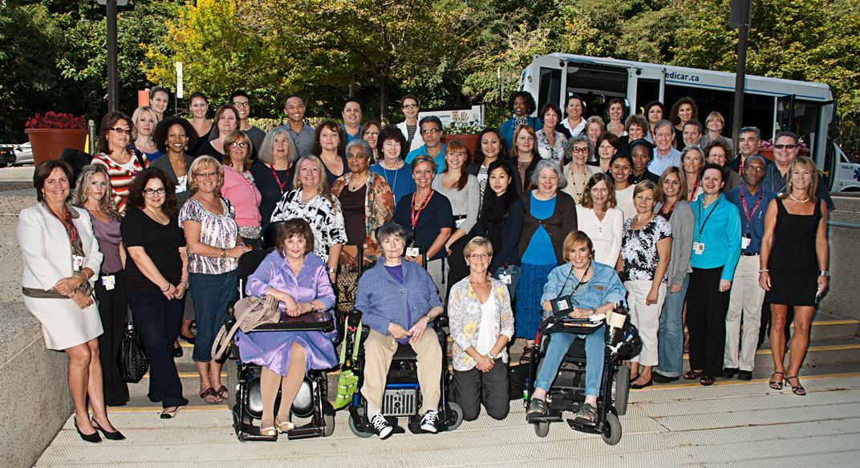
Successful Partnerships in Co-Designing Care
“Thank you for giving us this project. We are discovering our strengths and we are working together. Who would have thought this would be possible? (President, MUHC Patients Cttee)
Notes:
17
17
This quote from the President of our Patients committee who was also a TCAB pt advisor sums up well how we all felt.
“Thank you for giving us this project. We are discovering our strengths and we are working together. Who would have thought this would be possible?

Slide 18
System Leadership – Patient and Family Engagement & Partnership
Saskatoon Health Region Journey

Slide 19
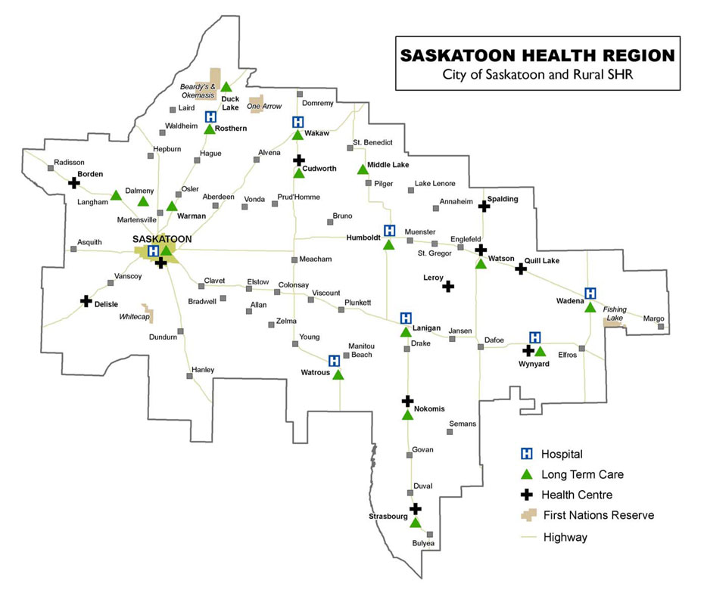

Setting the Context

Slide 20


The Patient First Review -2009
Notes:
Results released in October of 2009
Called for changes to how patients experience the health system, how health services are delivered, and how the system is administered.

Slide 21
What we learned?
We need to focus on:
Improving the patient experience; system performance and leadership
Guiding Principles
  “Patient First” must be embedded as a core value in health care;
  Health care in Saskatchewan needs to function as a cohesive system;
  Point of care providers must be empowered to deliver patient and family-centered care.

Slide 22


Provincial Structure PFCC- 2010
Provincial
Patient and Family Centred Care Forum
13 Health Regions

Slide 23
SHR Patient & Family Engagement
Regional Client & Family Centered Care Advisory Committee (2007)
Today 18 Patient & Family Advisory Councils work at program level (i.e. homecare, critical care)
Resident Councils – Long Term Care
Structures and processes focused on recruitment, orientation, ongoing support
180 patient family advisors
  working groups (ie open presence)
  Strategic projects ( i.e. safety alert system, Children’s Hospital)
  Development – i.e. policy or patient information
  Improvement and design events
  Interview panels – charge nurses, Directors, Vice Presidents, CEO
  Board meeting, QCC committee
  Medical, Nursing and Pharmacy student - Patient experience program

Slide 24
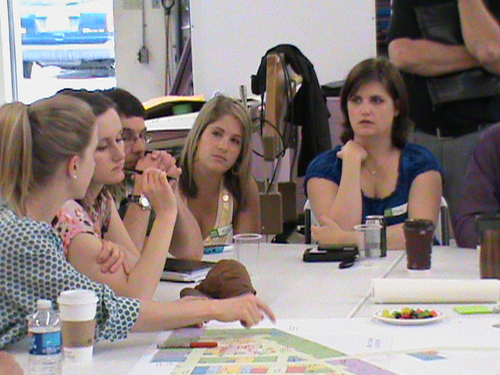
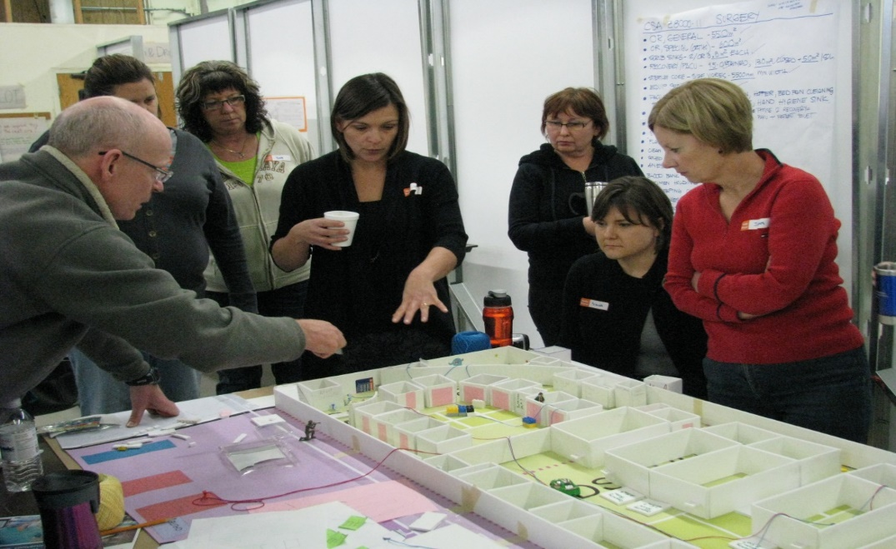
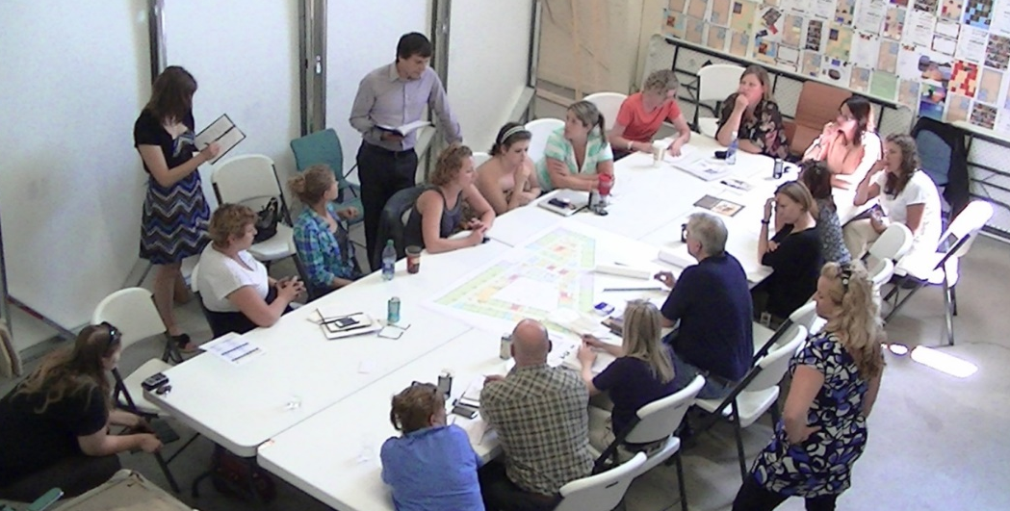
The Co Design Journey
2011 – Children’s Hospital of Saskatchewan Design Sessions
  patient advisors embedded into teams of staff, physicians, leaders, and community partners
  Started with principles created together and each design measured against the shared principles
  Crucial conversations, pushed our thinking of what was possible

Slide 25

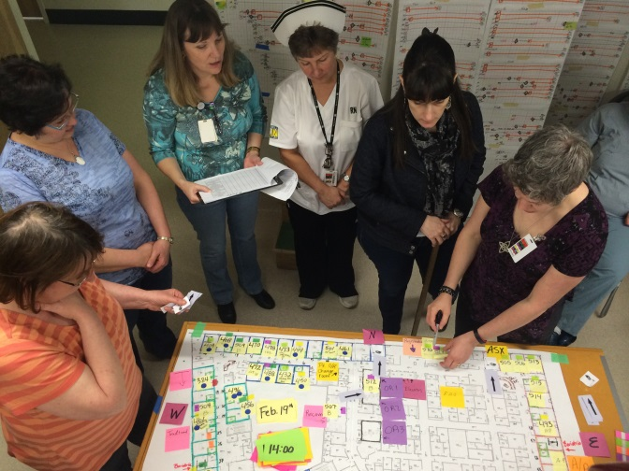
The Co Design Journey
3P: production preparation process
  Children’s hospital; Safety Alert System; Care Delivery Model
Rapid Process Improvement Events
  smaller scale week long event
  patient advisor core member of team which includes staff and physicians whose process is being examined and improved

Slide 26

Reflections
This is a journey not a destination
It is the responsibility of every leader to listen to and engage with those we have the privilege to serve.
I can never assume I know what the patient and family need or want, I have to ask, listen, learn and design together
It requires humility and vulnerability

Slide 27
Reflections
It is important to embrace the uncomfortable tension, If there is no tension nothing is changing
Patients/families are more than participants, moving toward coproduction
Staff and physicians also need support in working in this new way
Need to ensure we hear from everyone, including those who are most vulnerable. This required time to engage communities, to learn and build trust. Sill lots of work to do in this area

Slide 28
Improved health outcomes & changes in service utilization
Patient & organizational improvements e.g patient experience, safety and effectiveness
Changes in
improvement priorities
& resourcing
Source: Carman, et al.,
Health Affairs, 2013
Notes:
Last year at MUHC ISAI I talked about IAP2 and foundaitons for meaningful engagement…
Reference Carman and handout…
Note interplay between levels
Note value – ROI at each level
1) Direct care – patient engagement often referered to as patient activitation (define) and measured with PAM measure
http://e-patients.net/archives/2015/03/health-affairs-activation.html reference J. Greene
Note associated with improved health outcomes such as HDL, obesity,
Service utilization – fewer hospitalization and ED visits
2) Org design and governance (Note ROI from Baker and Judd CFHI Evidence Boost: benefits for organizations and service design and delivery – esp safety and effectiveness
3) Policy making: e.g. from Antoine Bovin’s work (Implementation Science article) . “Patient involvement can change priorities driving healthcare improvement at the population level”. Priorities established by professionals alone placed more emphasis on the technical quality of CDM. Patients placed more emphasis on required resources to support self-mgt and communication tools and development for provider-patient relationships. Note: why providers need to be supported with new trainining and education for different role and communication with patients for shared decision making (coach role vs fixer role)
NOTE: organizations that support engagement at all 3 levels of health care systems and all levels of engagement see greater benefits for all involved!!!

Slide 29
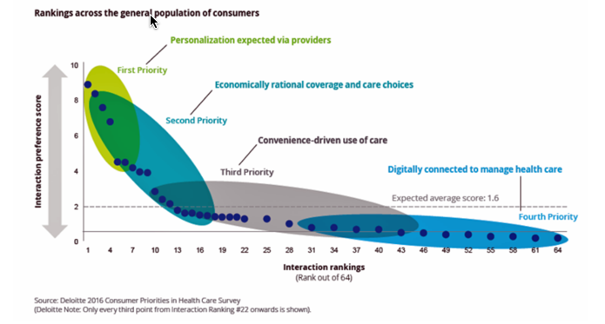
Designing 21st Century Healthcare
Patient engagement aligns with other potent trends
  Digital health resources for clinicians and citizens
  The incorporation of social and behavioral insights into evidence based practice
  A focus on health strategies to reduce the burden of disease
Notes:
Deloitte Survey on Consumer Priorities in Healthcare, 2016
“See me, feel me, touch me, heal me,” is the lyrical refrain from The Who’s Tommy. These eight words summarize what Deloitte has learned from the firm’s latest look into healthcare consumers, published in the report, Health plans: What matters most to the health care consumer. U.S. consumers’ demands for health care are for: Personalization from doctors, hospitals, and other care providers — the most important priority; Economically rational coverage and care choices; Convenience-drive access and care experience; and, Digitally connected care. Personalization is Job 1: “Consumers want to be heard, understood, and given clear directions through a personalized health care
http://www.healthpopuli.com/category/patient-engagement/

Slide 30


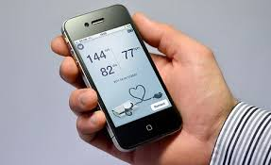

Digital Clinicians Engage E-Patients

Slide 31
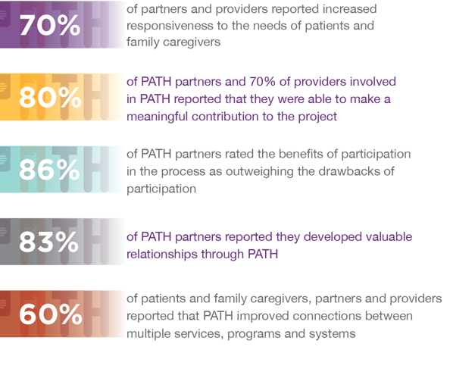
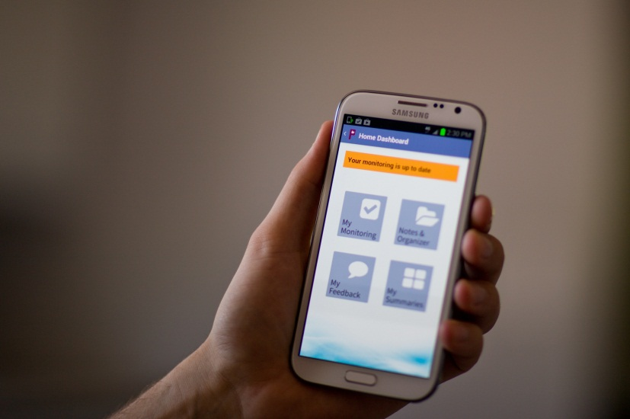
Northumberland Community Partnership
Notes:
Pay attention to the balance between the time and energy spent engaging with patients and families and the time and energy spent engaging with providers. This is particularly important as it relates to providers and staff who work in partner organizations other than the lead one (in PATH’s case, the hospital). When a project deliberately sets out to bring patients and families into the centre of decision-making, it will naturally spend a lot of time establishing that process. However, further into the project, the implementation of change will rely on staff and provider commitment to the vision. If this is not secured at the start, success will be harder to achieve.

Slide 32
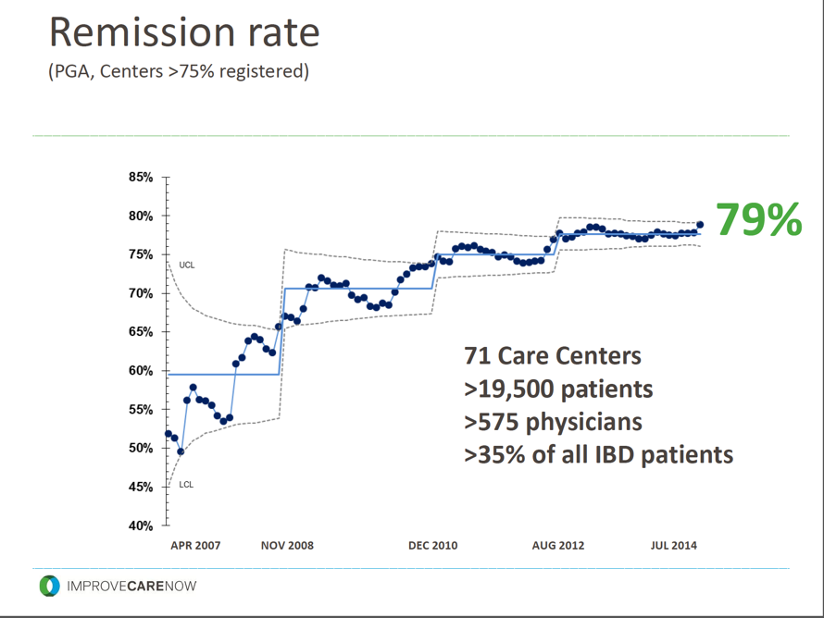
Patient Insights Inform Research and Practice
With leadership from Cincinnati Childrens’, patients and families engage with clinicians in a network to improve care for inflammatory bowel disease
IBD patients and families are the co-designers of care: linking knowledge of the patient experience with evidence of effective practices to ensure appropriateness and value to patients and the health system
This work has now expanded to 71 pediatric gastroenterology clinics across the US
Participating clinics have seen remissions for pediatric IBD patients increase from 55% to 79% of enrolled patients.

Slide 33
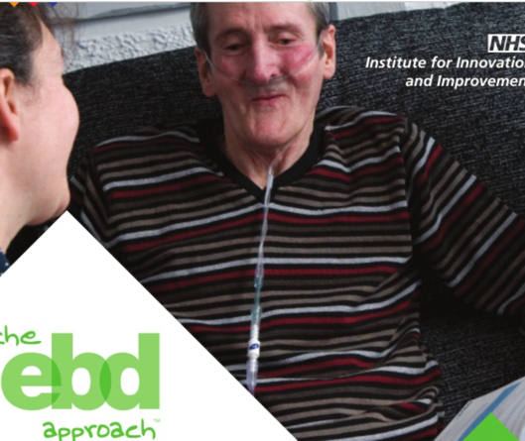
A Focus on Health and Healthcare
Patients and clinicians are co-designing strategies that go beyond disease management
Moving “upstream” to identify strategies
Patient communities help to bridge service gaps in healthcare and community services

Slide 34


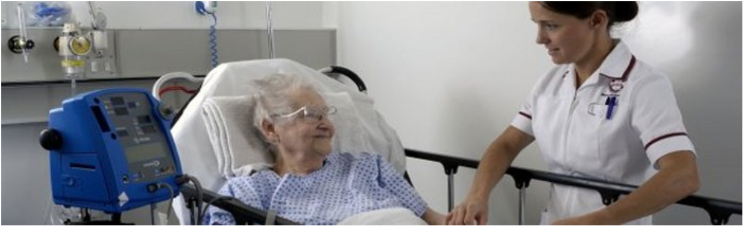

This north London service for COPD has won national awards for improving and integrating respiratory services across hospital and the community, patient involvement, multi-disciplinary teamwork and quality improvement.
Key outcomes include reductions in hospital length of stay, 90 day mortality of COPD patients at 2.6% versus 8.6% nationally

Slide 35
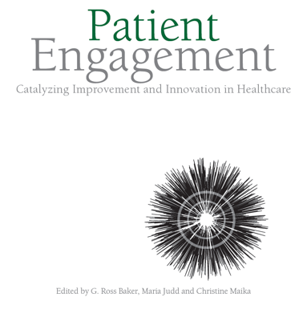
Contributors:
G. Ross Baker
Maria Judd
Christine Maika
Carol Fancott
Patricia O’Connor
Alain Biron
Brenda MacGibbon
Eleanor Rivoire
Anu MacIntosh-Murray
Jocelyn Cornwell
Louise Restrick
Annie Laverty
Jean-Louis Denis
Caryl Harper
Elina Farmanova
Peter Margolis
Justin Vandergrift
Michael Seid
Malori Keller
Glenn Robert
Vincent Dumez
Jim Conway

Slide 36

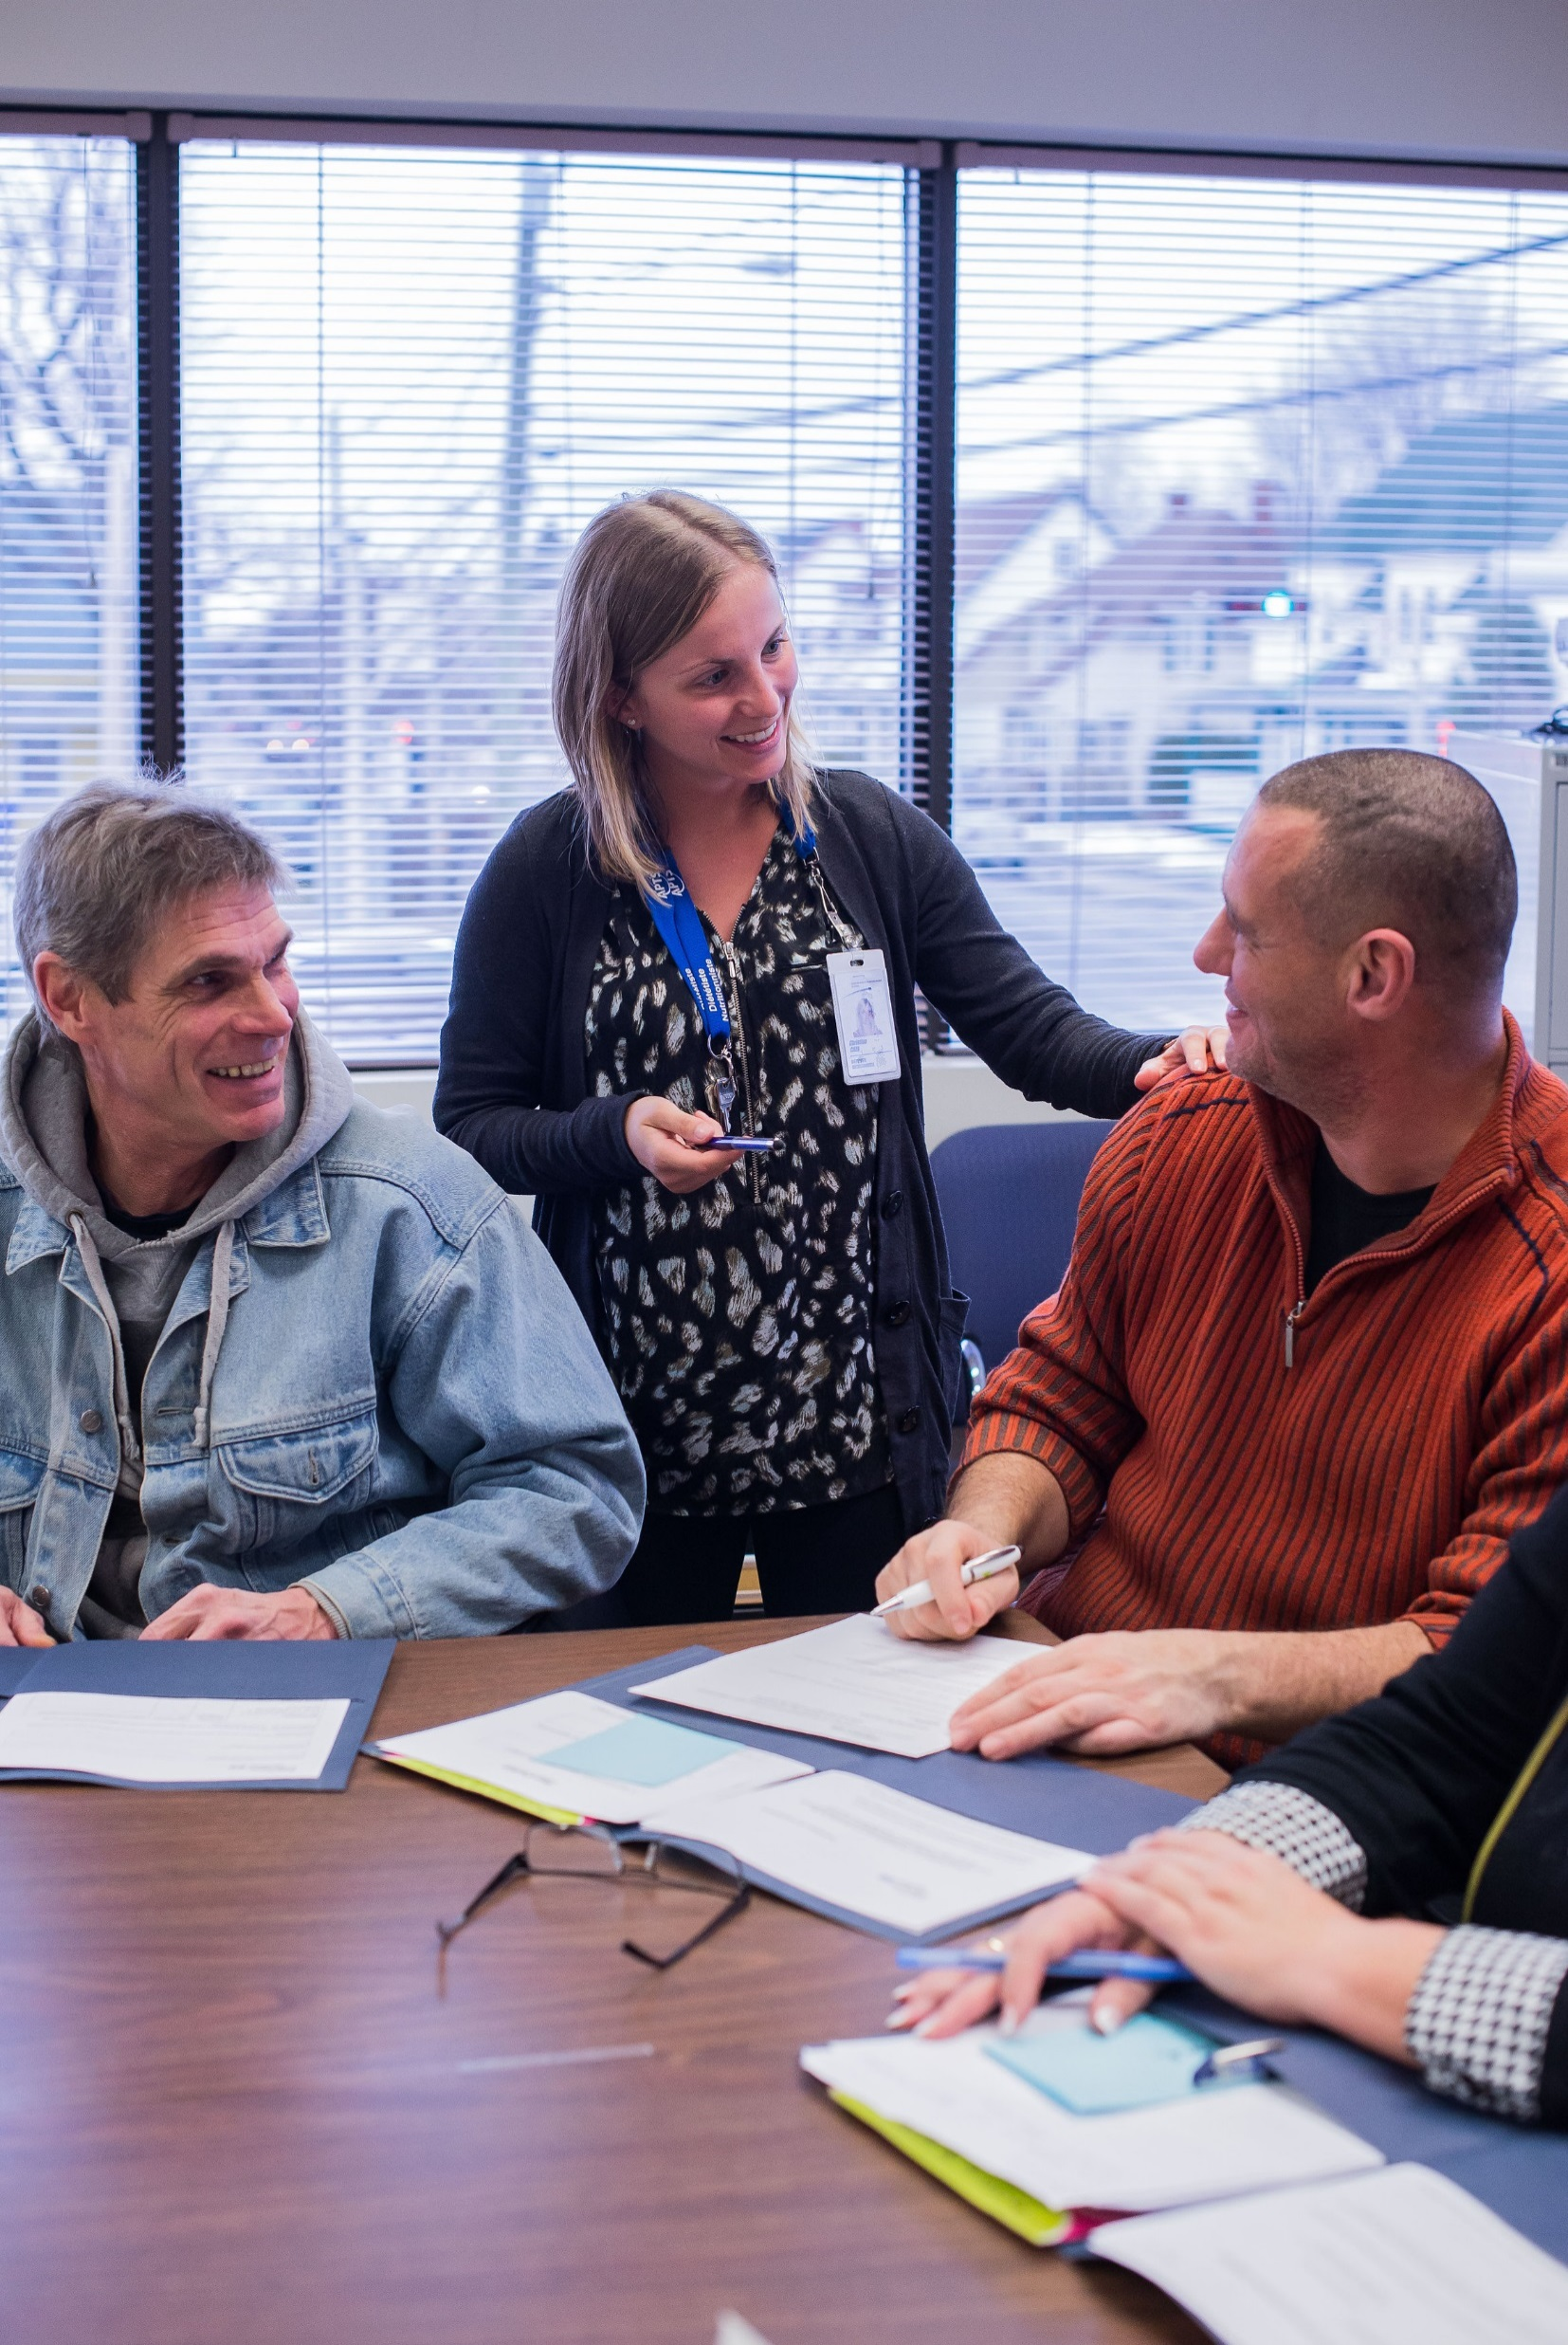
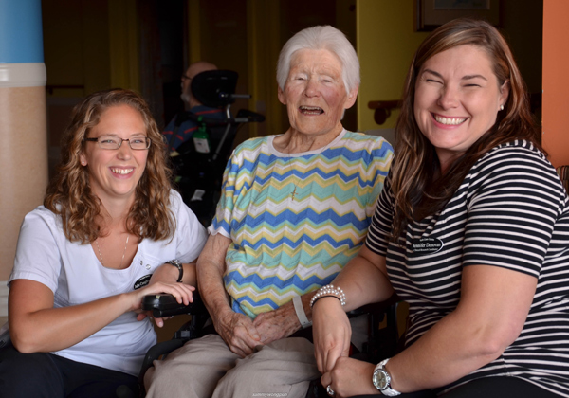
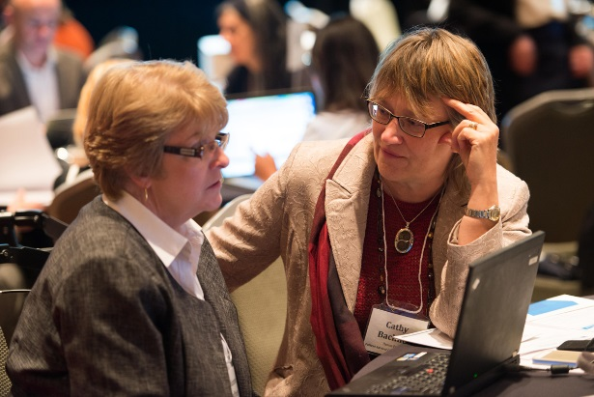
Q & A

Slide 37

Thank You!
Patricia O’Connor
Patty.Oconnor1@gmail.com
Maria Judd
Maria.Judd@Cfhi-fcass.ca
Petrina McGrath Petrina.McGrath@saskatoonhealthregion.ca
Ross Baker
Ross.Baker@utoronto.ca

